Slide 1


Use of Community Health Data for Shared Accountability
Tariq Azim, MBBS, DM
MEASURE Evaluation
John Snow, Inc.
Stephanie Mullen, DrPH
MEASURE Evaluation
John Snow, Inc.
February 2018

Slide 2
The Community Is Not in the Spotlight
Dissemination and use of data generated by the health system are traditionally limited to the health system.
The community is not viewed as:
  A decision maker when it comes to the health system
  A consumer or user of health data
As a result:
  The community is disengaged and does not play an active role in improving its own health status.
  The health system is not held accountable to the community it serves.
  Promotion of community involvement is externally driven.
  There is a lack of community leadership and ownership of interventions to improve the community’s own health.

Slide 3
Community Ownership & Accountability
Ownership requires:
  Taking responsibility
  With that comes accountability
Accountability:
  Committing to decisions and/or actions and holding oneself answerable for those actions and their consequences

Slide 4
Shared Accountability to Ensure Health
Shared accountability is defined as a process by which partners hold one another responsible for the commitments that they have voluntarily made to each other (Institute of Medicine, 2011).
Both the community & the health system (public and/or private) are accountable for:
  Sharing health and related information
  Taking actions to improve/maintain health
  Publicly reporting and answering questions about those decisions and/or actions

Slide 5
Shared Accountability for Health at the Community Level
Purpose:
  Create an enabling socio/political environment of mutual trust and transparency between the community and the health system
  Support the taking of collective responsibility and commitment to shared accountability to improve health service delivery
  Contribute to the overall health of the community

Slide 6
Basic Principles: Community Health Data Use for Shared Accountability
The community takes the leadership role in running the forum/meeting
Use an existing forum at the community level
The community and the health system both share health and related data/information
  Health status, service coverage, disease occurrences, service availability, maternal & infant deaths
Mutually decide on the health priorities and voluntarily commit to taking responsibility for addressing health priorities
Promote transparency and open sharing of data while ensuring privacy and security

Slide 7
Qualitative Monitoring of Forum Performance
Legend: Green = desired performance Yellow = acceptable performance Red = unfavorable situation |  | Health System
 |  | Shared Information | Took Actions
Community | Shared Information | Box 1: Both the health system and the community shared information | Box 2: Community provided information; health system acted on it (health system’s responsiveness)
 | Took Actions | Box 3: Health system shared information; community acted on it (community engagement in taking action) | Box 4: No information was shared, but both the health system and community acted on their own

Slide 8
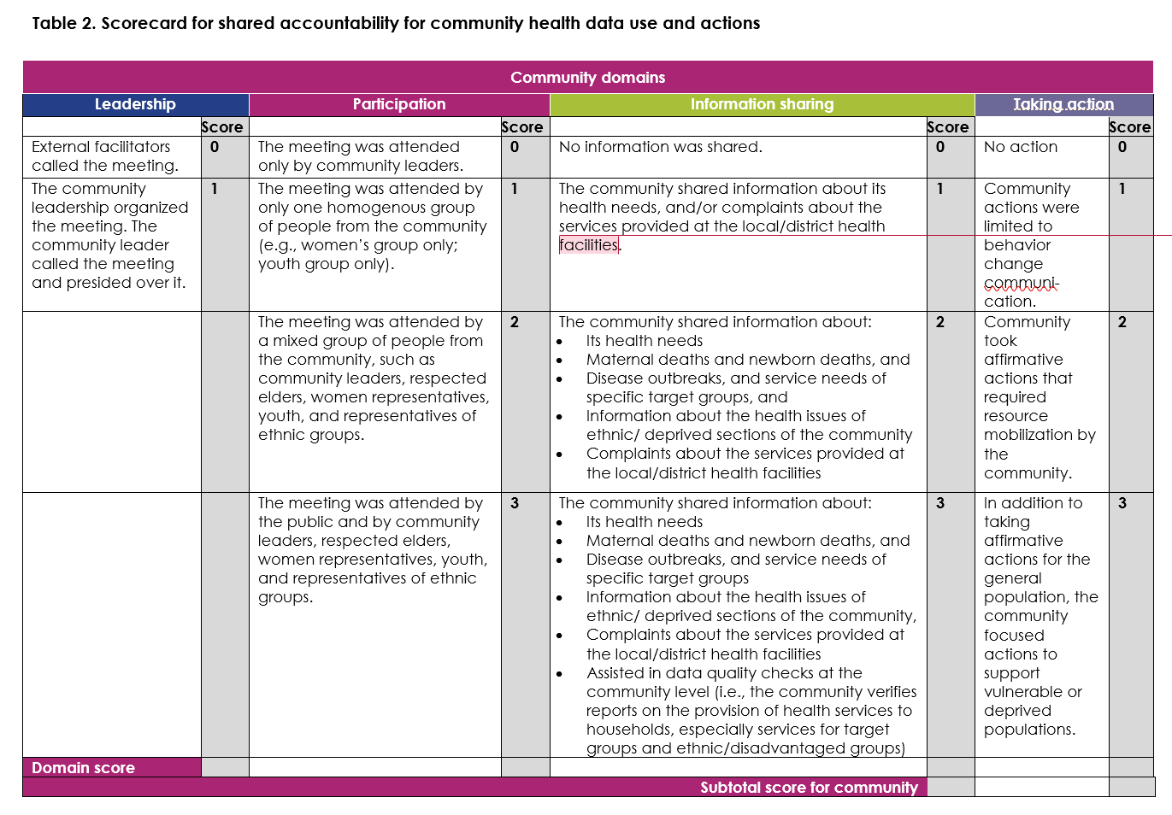
Quantitative Monitoring of Forum Performance

Slide 9
Shared Accountability: Cases
Disease epidemics: sharing responsibilities and working in tandem
  Liberia Ebola crisis
    There was widespread noncompliance with government-imposed cremation to prevent viral spread.
    Traditional and religious leaders influenced the development of World Health Organization guidelines on safe burials with dignity, which became government policy at the end of 2014.

Slide 10
Shared Accountability: Cases
Community-based maternal death surveillance
  Accra, Ghana
    A modified survey system of community-based reproductive age mortality using six questions was implemented in the Bosomtwa district of Accra
  Malawi
    Community-linked maternal death review: Communities and health facility staff worked in partnership to investigate and respond to maternal deaths occurring in communities and at health facilities

Slide 11
Shared Accountability: Cases
Community-based tuberculosis directly observed treatment, short course (TB-DOTS): accountability on both sides
  Mozambique
    Clients choose their DOTS with support from the local volunteers, known as padrinhos
      Example of community taking responsibility for supervising TB-DOTS
      Padrinhos make themselves accountable to the larger community regarding adherence to DOTS by the clients of TB services.

Slide 12
This presentation was produced with the support of the United States Agency for International Development (USAID) under the terms of MEASURE Evaluation cooperative agreement AID-OAA-L-14-00004. MEASURE Evaluation is implemented by the Carolina Population Center, University of North Carolina at Chapel Hill in partnership with ICF International; John Snow, Inc.; Management Sciences for Health; Palladium; and Tulane University. Views expressed are not necessarily those of USAID or the United States government.
www.measureevaluation.org

